Slide 1

Binary Tree
Presented By:
Jayasurya M
Maadhesh M
Rajesh Kannan M
Varun J
Barakathul Fathima Mohammed

Slide 2
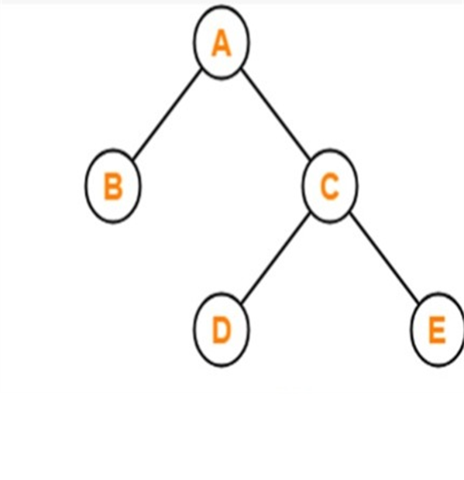
Binary Tree
Binary Tree is a tree data structure where each node has at most 2 children.
Since each element in a binary tree can have only 2 children, we typically name them the left and right child.
A binary tree is a hierarchical data structure composed of nodes connected by edges.
Binary Tree

Slide 3
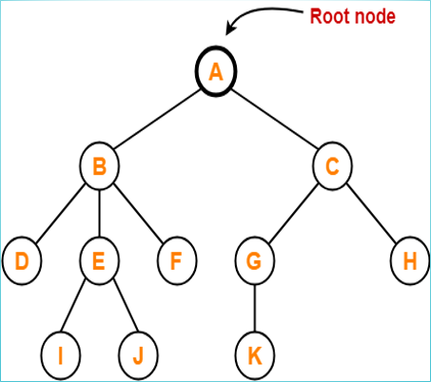
Tree terminology
The first node from where the tree originates is called as a root node.​
The connecting link between any two nodes is called as an edge​
Links from node to its successors are called branches​
Predecessor of a node are called its parent
Successors of a node is called its ​children
Nodes with same parent are siblings​
Nodes with no children are called leaf nodes
Binary Tree

Slide 4
Use Cases of Binary Trees:
Binary trees are fundamental in various algorithms and data structures due to their efficient and hierarchical nature. They provide quick access, insertion, and deletion operations.
Database Indexing: Binary Search Trees (BST) are commonly used for indexing in databases, providing efficient search and retrieval of data.
File Systems Organization: Binary trees help organize and navigate file systems efficiently, allowing for quick searches and hierarchical organization.
Arrays: Binary trees offer dynamic size and efficient insertion and deletion compared to arrays.
Linked Lists: Binary trees provide faster search operations compared to linked lists.
Binary Tree

Slide 5
Creation of the Binary Tree
A binary tree is made of nodes. The nodes are like that of linked lists.
A node has these component:
Data
Reference to left child
Reference to right child
1
/ \
2 3
/ \
4 5
Binary Tree

Slide 6
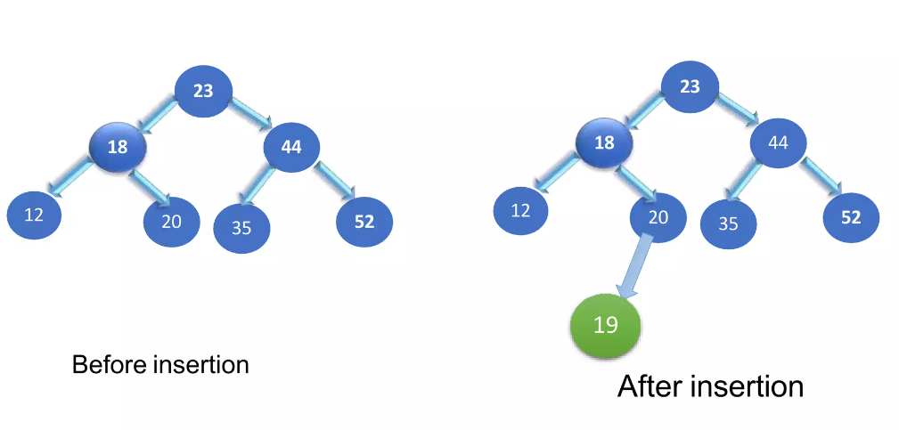
Binary Tree- Insertion
For insert data in binary tree two conditions we have to faced:
1. IF tree is empty than insert to a new node make them root node.
2. If tree is not empty than all inserts take place at a leaf or at node.
Left subtree have less values and Right subtree has greater value.
Binary Tree

Slide 7
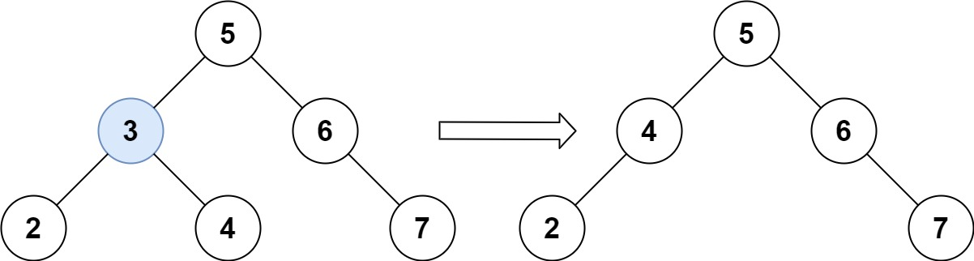
Binary Tree- Deletion
Case 1: The Node to Be Deleted has No Children Case 2: The Node to Be Deleted has One Child Case 3: The Node to Be Deleted has Two Children. (Code Link)
Binary Tree

Slide 8
Size of the binary tree
Size of a binary tree is the total number of nodes present in the tree.
It includes all nodes including the root, internal nodes, and leaf nodes.
Possible Cases:
Size of an empty tree. (Tree with no nodes)
Size of a non-empty tree. (Tree with more than one node)
6 ← Size 1
/ \
4 8 ← Size 3
/ \ / \
3 5 7 9 ← Size 7
Syntax:
SizeOfBinaryTree = SizeOfLeft + SizeOfRight + 1
Binary Tree

Slide 9
Height of the binary tree
Height of a binary tree is the length of the longest path from the root node to a leaf node.
It’ll be calculated by calculating the maximum depth of the left and right subtree recursively.
Possible Cases:
Height of an empty tree. (Tree with no nodes)
Height of a single node tree. (Tree with only one node)
Height of a non-empty tree. (Tree with two or more nodes)
5 ← Height 0
/ \
3 6 ← Height 1
/ \
2 4 ← Height 2
Syntax:
HeightOfBinaryTree = max(MaxDepthOfLeftSubtree,
MaxDepthOfRightSubtree) +1
Binary Tree

Slide 10
Searching in the binary tree
Searching for a node in a binary tree involves traversing the tree to find a specific value or key.
It involves checking whether a value or key is present in the tree or not.
Methods for searching node:
Recursive Search
Iterative Search
Program Code
6
/ \
4 8 ← Found 8
/ \ / \
3 5 7 9
Binary Tree

Slide 11
BINARY TREE TRAVERSAL
Binary tree traversal is a fundamental operation in working with binary trees, and it plays a significant role in various applications. The primary significance of binary tree traversal includes:
Data Retrieval
Data Insertion and Deletion
Expression Evaluation
Sorting
Path Finding and Tree Analysis
Understanding and implementing various traversal algorithms are crucial for efficiently managing and manipulating data in binary trees, making them versatile data structures in computer science. Different traversal orders (in-order, pre-order, post-order, level-order) serve different purposes based on the requirements of the application or problem at hand.
Binary Tree

Slide 12
IN-order TRAVERSAL
In this traversal, you start from the leftmost node of the tree and visit its left subtree, then visit the node itself, and finally, visit its right subtree. The order of visiting ensures that the nodes are processed in ascending order in the case of a binary search tree (BST). <CODE>
50
30
20
40
70
60
80
20, 30, 40, 50, 60, 70, 80
Binary Tree

Slide 13
PRE-order TRAVERSAL
In this traversal, you start from the root node, visit the node itself, then recursively visit its left and right subtrees. The order of visiting is such that you process the node before its descendants.
When creating a deep copy of a binary tree, pre-order traversal is often used to visit and copy nodes.
50
30
20
40
70
60
80
50, 30, 20, 40, 70, 60, 80
Binary Tree

Slide 14
POST-order TRAVERSAL
In post-order traversal, you start from the leftmost leaf, traverse its subtrees (left and right) recursively, and finally, visit the root. The order of visiting ensures that you process the node after its descendants. When deallocating memory in a binary tree, post-order traversal ensures that child nodes are deleted before their parent nodes.
50
30
20
40
70
60
80
20, 40, 30, 60, 80, 70, 50
Binary Tree

Slide 15
LEVEL-order TRAVERSAL
It is a method for visiting all nodes in a binary tree level by level. It uses a queue to keep track of the nodes at each level, ensuring that nodes are processed in the order they appear from left to right at each level. It is used for searching in graphs and trees, finding the shortest path, or determining connected components. <CODE>
50
30
20
40
70
60
80
50, 30, 70, 20, 40, 60, 80
Binary Tree

Slide 16
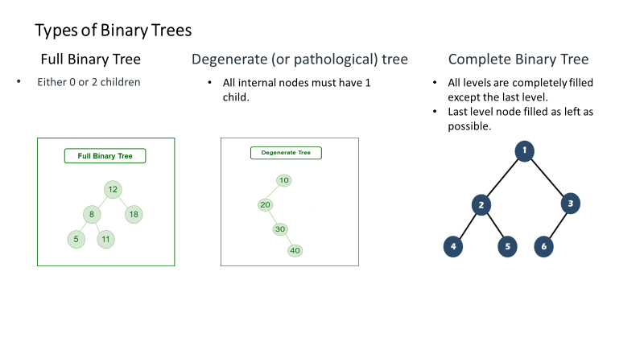
Binary Tree

Slide 17
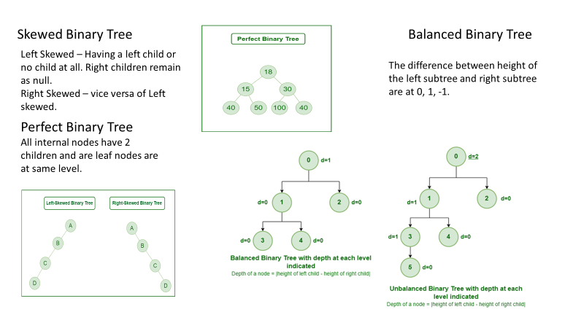
Binary Tree

Slide 18
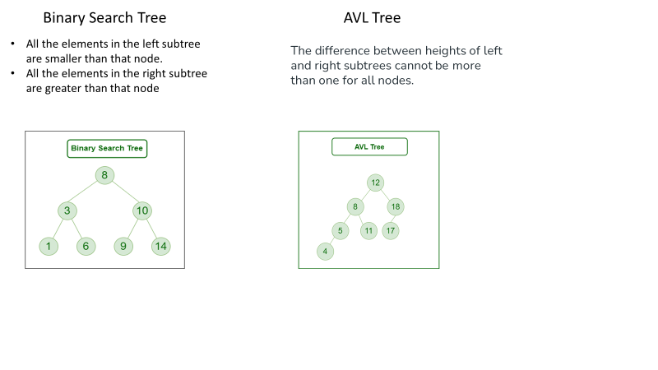
Binary Tree

Slide 19
Advantages of Binary Tree
Efficient Searching
Ordered Traversal
Fast insertion and deletion
Useful for sorting
Disadvantages of Binary Tree
Limited Structure
Space Inefficient
Slow performance in worst case scenarios
Unbalanced Trees
Binary Tree

Slide 20

Thank you!
capgemini.com

